Slide 1

PHYS1001
Physics 1 REGULAR
Module 2 Thermal Physics
SECOND LAW OF THERMODYNAMICS
ENTROPY AND DISORDER:
MICROSCOPIC & MACROSCOPIC VIEWS
PHYSICS: FUN EXCITING SIMPLE
dell/ap06/p1/thermal/ptF_entropy.ppt

Slide 2
Second Law of Thermodynamics and Entropy
Second Law of Thermodynamics, Entropy: microscopic view, macroscopic views
§19.1 p646 §20.5 p682 §20.8 p697 §20.7 p690
§20.6 p684 §20.2 p675
References: University Physics 12th ed Young & Freedman
Ludwig Boltzmann (1844 – 1906) who spent much of his life studying statistical mechanics died by his own hand. Paul Ehrenfest (1880 – 1933), carrying on his work, died similarly. So did another disciple, Percy Bridgman (1882 – 1961).
Perhaps it would be wise to approach this subject with caution.
David Goodstein

Slide 3
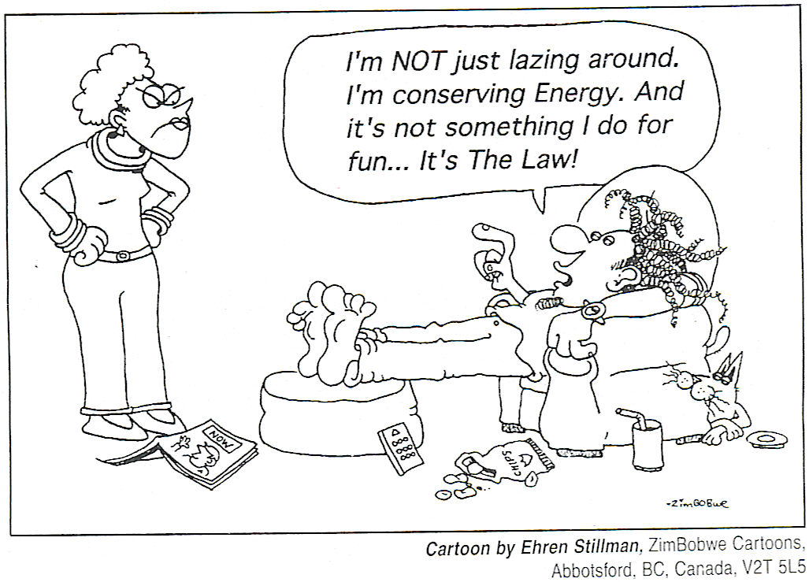
1st Law
What does the 2nd Law tell us?
* spontaneous heat from hot to cold - reverse is NOT true why ?
* 100% mechanical energy to heat (amount of energy transferred by a
temperature difference) reverse is NOT true why ?

Slide 4
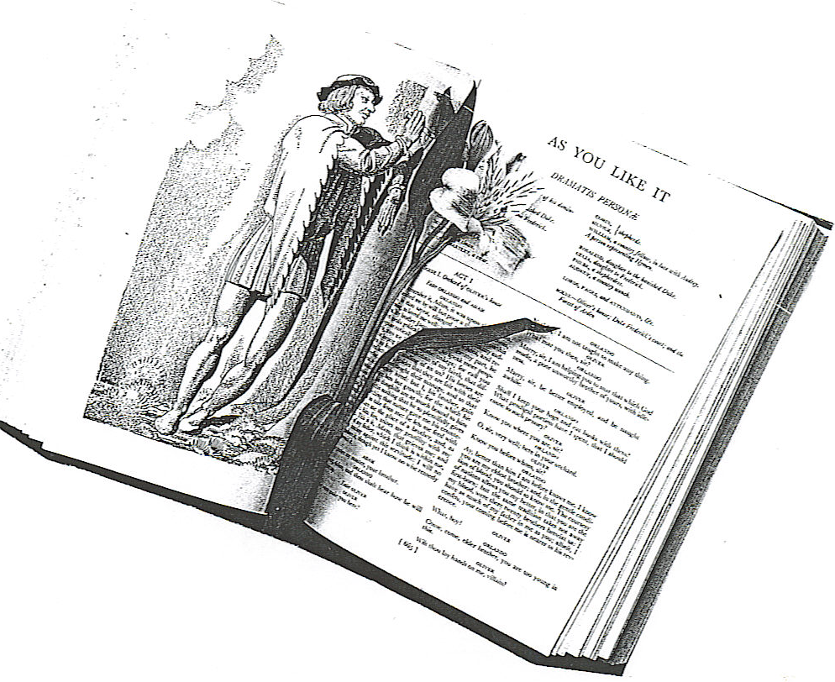
2nd Law:
A good many times I have been present at the gatherings of people who, by the standards of traditional culture, are thought highly educated and who have with considerable gusto been expressing their incredulity at the illiteracy standard of scientists. Once or twice I have been provoked and have asked the company how many of them could describe the Second Law of Thermodynamics. The response was cold: it was also negative. Yet I was asking something which is about the scientific equivalent of: Have you read a work of Shakespeare’s ?
C.P. Snow (1905 – 1980)

Slide 5
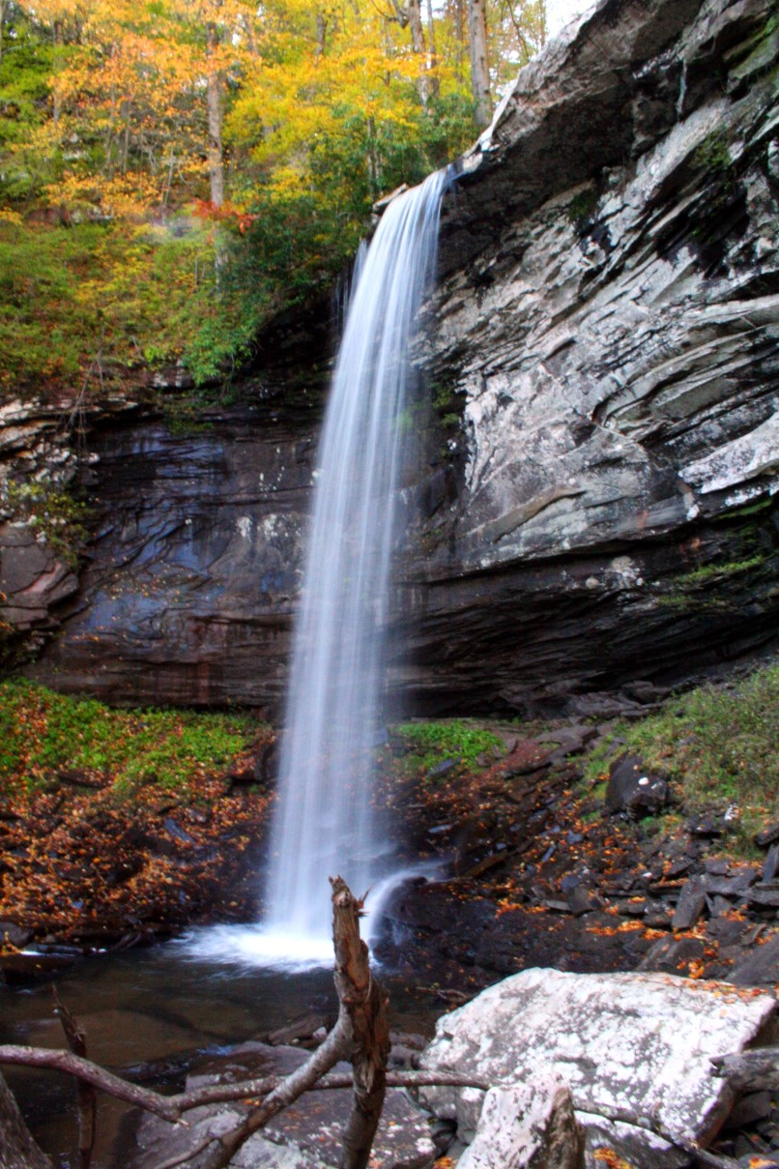
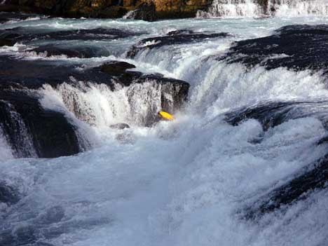
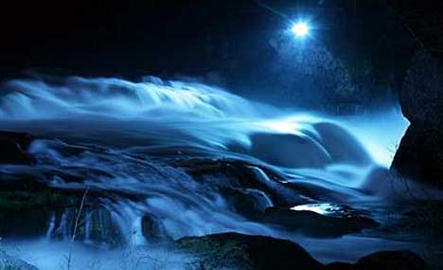
Why does the water never run up the waterfall ?

Slide 6
The arrow of time

Slide 7
SECOND LAW OF THERMODYNAMICS
For an isolated system, the direction of spontaneous change is from
* a situation of lesser probability to a situation
of greater probability
* order to disorder
The entropy of an isolated system increases or remains the same.
Entropy increases, energy becomes less available, and the universe becomes more random or more “run down”.

Slide 8
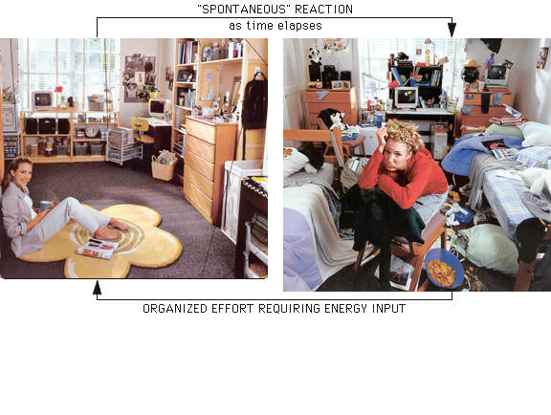
Entropy – quantitative measure of disorder

Slide 9
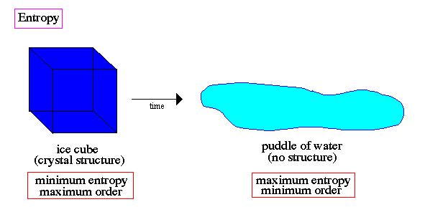

Slide 10


Disorder (randomness) and thermal processes
Heat transfer involves changes in random, chaotic, disordered motion of the molecules, therefore, conversion of mechanical energy to “heat” increases the randomness of disorder – increase in entropy.
Plotkin's Entropy
William G. Clark, Entropy

Slide 11
Microscopic Interpretation of Entropy
Configurations (macrostates) associated with large numbers of microstates, w are said to be more complex or more disordered than those with fewer microstates. The equilibrium state of a system is the most disordered configuration (largest no. of microstates) available. The Austrian physicist Ludwig Boltzmann introduced a measure of disorder called the entropy S defined by
Boltzmann constant
[S] = J.K⁻¹
The scientific achievement of Boltzmann was outstanding. He discovered a completely new pathway in theoretical physics, however, his work was ridiculed by his fellow German professors.

Slide 12
Card playing – For Example: Bridge
Macrostate 1 13 / 0 / 0 / 0 | Jill | Jack | Bruce | John
clubs | A-K-Q-J-10-9-8-7-6-5-4-3-2
diamonds |  | A-K-Q-J-10-9-8-7-6-5-4-3-2
hearts |  |  | A-K-Q-J-10-9-8-7-6-5-4-3-2
spades |  |  |  | A-K-Q-J-10-9-8-7-6-5-4-3-2
This set of cards is well-ordered (w = 1) and it would be very surprising to see such an arrangement. The chance of getting this configuration (macrostate) is 1 in 2×10²⁷.
Notes:
Also possible: 4 microstates!
13/0/0/0
0/13/0/0
0/0/13/0
0/0/0/13

Slide 13
Macrostate 2 4 / 3 / 3 / 3 | Jill | Jack | Jan | John
clubs | A J 6 5 | K 9 7 | 10 3 2 | Q 8 4
diamonds | K 7 5 | Q J 8 | 4 3 2 | A 10 9 6
hearts | Q 6 2 | J 8 7 5 | K 10 9 | A 4 3
spades | 8 6 3 | K J 4 | A 7 5 2 | Q 10 9
What is the chance of getting this configuration (4 / 3 / 3 / 3)?
What is the number of microstates w?
Macrostate 1 is much more ordered than macrostate 2. In microstate 2 we know very little about where an individual card is located.

Slide 14
Macrostate 2 4 / 3 / 3 / 3 | Jill | Jack | Jan | John
clubs | AJ65 | K97 | 1032 | Q84
diamonds | K75 | QJ8 | 432 | A1096
hearts | Q62 | J875 | K109 | A43
spades | 863 | KJ4 | A752 | Q109
This set of cards is disordered (w very large) and is the type of arrangement 4 / 3 /3 / 3 that one commonly sees. The chance of getting this configuration (macrostate) is 1 in 2×10²⁷.

Slide 15
Both arrangements dealt have the same probability, but arrangement 2 is normal and arrangement 1 is very, very, … rare. Although the arrangement 2 is improbable as any other, it is representative of a large number of hands of the type 4 of one suit and 3 of the other suits. A single hand such as 4/3/3/3 can be obtained in any one of 1.7×10¹⁰ ways. This means that if we play many games of bridge we see many occurrences of this 4/3/3/3 arrangement.

Slide 16
Coin game
Consider a game of throwing coins into the air and then counting the number of heads and tails.
For N coins, the total number of microstates = 2^{N}
For h heads and t tails, the number of microstates = N! / h! t!
Probability of a macrostate
= no. of microstates / total no. microstates
=

Slide 17
Macrostate 1: 4h / 0t
Microstates: (hhhh) prob = 1/16 w = 1 S/k = ln(1) = 0
Macrostate 2: 3h / 1t
Microstates: (hhht) (hhth) (hthh) (thhh)
prob = 4/16 w = 4 S/k = ln(4)
Macrostate 3: 2h / 2t
Microstates: (hhtt) (htth) (tthh) (thht) (htht) (thht)
prob = 6/16 w = 6 S/k = ln(6)
Macrostate 4: 1h / 3t
Microstates: (httt) (thtt) (ttht) (ttth)
prob = 4/16 w = 4 S/k = ln(4)
Macrostate 5: 0h / 4t
Microstates: (tttt)
prob = 1/16 w = 1 S/k = ln(1)= 0
4 COINS
# microstates = 2^{N} = 2⁴ = 16
5 macrostates
Most likely macrostate
Most number of microstates
Greatest entropy
S = k ln( w )
Highest probability

Slide 20
Molecules of air in a box
For molecules in a box, there are too many molecules to use the laws of motion to keep track of them – a statistical or probability approach must be used. How do we expect the molecules to spread out? There is no fundamental law of physics that says they must be evenly distributed – rather, it is a matter of probabilities.
Box size 1 m³
No. of molecules 10²⁵
Size of cell 10⁻⁶ m³
No. of cells 10⁶
No. of ways of getting all molecules
into a single cell = 1
Entropy S = k ln(w) w = 1 S = 0

Slide 21
No. of ways of arranging molecules evenly among cells is
Entropy S = k ln(w)
k = 1.38×10⁻²³ J.K⁻¹
S = (1.38×10⁻²³ J.K⁻¹)(10²⁵) ln(10⁶) = 2000 J.K⁻¹

Slide 22
1000 particles moving randomly in a box
time = 0
Perfume released
How does it spread?
t = 20
t = 200
t = 400

Slide 25
There is no phenomena whereby an object will spontaneously leave a state of equilibrium. All natural processes proceed in such a way that the probability of the state increases – law of increasing entropy – it is one of the most important laws of nature – the Second Law of Thermodynamics.

Slide 26
SECOND LAW OF THERMODYNAMICS
For an isolated system, the direction of spontaneous change is from:
* A situation of lesser probability to a situation of greater probability.
* Order to disorder.
The entropy of an isolated system increases or remains the same.

Slide 27
Second Law of Thermodynamics: statements of what is impossible
Direction of thermodynamics processes: Heat always flows spontaneously from a hot object to a cooler one.
Irreversible processes (processes that proceed spontaneously in one direction but not other) – inherent one-way processes in nature - perfume from an open bottle will spread throughout a room – the perfume molecules will never spontaneous gather back into the bottle; miscible liquids left to themselves always tend to mix, not to un-mix.
All irreversible changes ΔS > 0 ⇒ entropy is not a conserved quantity

Slide 28
Macroscopic View of Entropy
ENTROPY measure of disorder e.g. when a gas is heated and expands, the gas is in a more disordered state and gas molecules have more randomness of position than before since they are moving in a larger volume.
Consider adding heat dQ and let the gas expand isothermally
dQ = dW = p dV = n R T (dV / V)
dV / V = dQ / n R T = n R dQ/dT
dV / V is a measure of the increase in disorder caused by the
expansion
definition (infinitesimal reversible process) ⇒

Slide 29
When a system changes state, there can be a change in the entropy
Q
state 1 S₁
state 2 S₂
reversible change

Slide 30
The entropy has a definite value for a particular state. When a change occurs from state 1 to state 2, the change in entropy is the same for all possible paths 1 to 2. This fact can be used to determine the entropy change for an irreversible process – simply invent a path from 1 to 2 that consists of entirely reversible processes.
Second law – when all systems taking part in a process are included, the entropy remains constant or increases ⇔ no process is possible in which the total entropy decreases, when all systems taking part in the process are included
All irreversible changes ΔS > 0 ⇒ entropy is not a conserved quantity
For all processes

Slide 31
Isothermal Process: T constant
ΔS = ∫ dQ / T ΔS = Q / T
In an isothermal expansion,
heat Q must be added to
keep T constant, in a process
where ΔT is small
Q = n R T ln( V₂ / V₁ )
ΔS = n R ln( V₂ / V₁ )
expansion: V₂ > V₁ ln(V₂ /V₁) > 0 ΔS > 0

Slide 32
For an adiabatic process: Q = 0
Q = 0 ⇒ ΔS = 0

Slide 33

Example
A mug of coffee cools from l00 °C to room temperature 20 °C. The mass of the coffee is m = 0.25 kg and its specific heat capacity may be assumed to be equal to that of water, c = 4190 J.kg⁻¹.K⁻¹.
Calculate the change in entropy
(i) of the coffee
(ii) of the surroundings and (iii) of the coffee plus the surroundings (the "universe").

Slide 34
Solution
The entropy of the coffee and of the surroundings will both change. In each case we consider the system of interest (first the coffee, second the surroundings) and look at the corresponding reversible change that takes the system from its initial to its final state. Note well that we are not claiming that the change occurred reversibly, we
are just imagining the reversible change so that we can calculate the entropy change in the real situation.

Slide 35
(i) Coffee: The coffee cools from l00 °C to 20 °C, i.e. from T₁ = 373 K to T₂ = 293 K.
The transfer of energy ΔQ from the coffee to its surroundings is given by the relation ΔQ = m c ΔT , or dQ = m c dT, where m is the mass of the coffee, c the specific heat capacity of the coffee and ΔT the change in temperature of the coffee while in contact with the reservoir/surroundings.
ΔS = (0.25)(4190) ln(293/373) J.K⁻¹ = - 253 J.K⁻¹
2nd Law??

Slide 36
(ii) Surroundings:
These remain at temperature 293 K while an irreversible flow of m c ΔT occurs. Note that this heat flow is calculated indirectly, in terms of coffee, where data needed for this calculation is available, rather than from values directly associated with the surroundings.
ΔS = + |ΔQ| / T = (m c |ΔT|) / T
ΔS = (0.25)(4190)(373 - 293)/293 = +286 J.K⁻¹
Positive since heat flows into the surroundings.

Slide 37
(iii) Coffee plus surroundings:
ΔS_{total} = ΔS_{coffee} + ΔS_{surroundings} = - 253 + 286 J.K⁻¹
ΔS_{total} = + 33 J.K⁻¹
As for all naturally occurring processes the net change in entropy is positive.

Slide 38
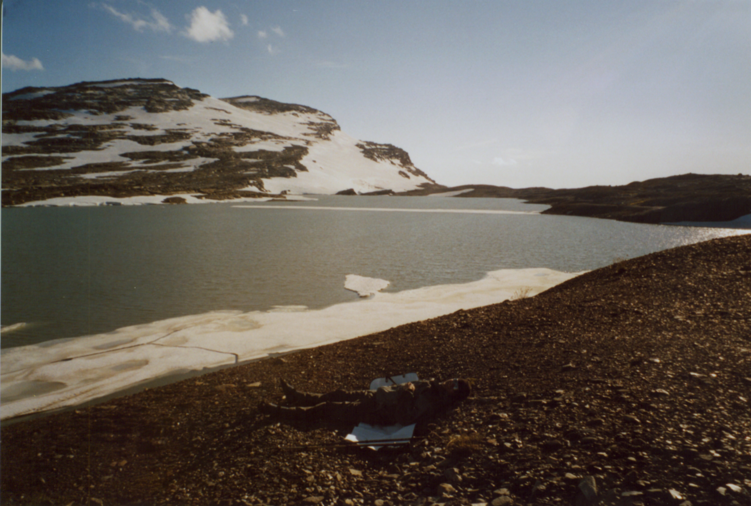

Example
A stone of mass 1.0 kg is dropped into a lake of water from a height of 3.0 m. Calculate the changes in entropy of the stone and of the lake.

Slide 39
Solution
At first sight, this might seem to be a mechanics sum. But there will be an energy transfer: potential energy of the stone to kinetic energy of stone to internal energy of the lake. Changes in entropy are associated with the energy transfers. Because of the size of the lake, its temperature is effectively unchanged. We also assume that there is
no difference between the temperatures of the air and the lake, so the temperature of the stone is also unchanged.

Slide 40
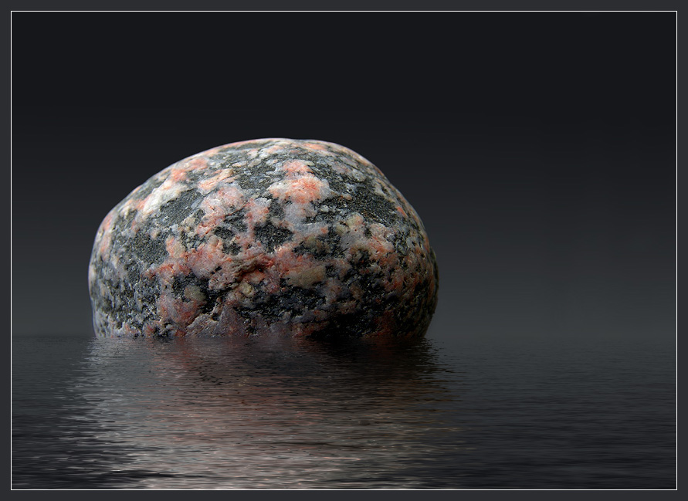
Stone:
The initial and final thermal states (internal energy, temperature, volume, etc.) are identical. The corresponding reversible change to be considered is extremely simple - no change. This means that the entropy change of the stone is zero.

Slide 41
Lake:
Take the energy that is transferred from the stone to the lake as being equal to the original potential energy of the stone. The corresponding reversible change is the transfer of heat flow to the lake.
Increase of entropy, ΔS = m g h / T
Assume
T = 300 K, m = 1.0 kg, g = 10 m.s⁻² and h = 3.0 m
ΔS = (1.0)(10)(3.0) / 300 = + 0.10 J.K⁻¹

